Slide 1
Building an HTML5 Game Engine
Andrew Brough & Bethany Dunfield

Slide 2
Basic Engine Concepts
Overview of a basic engine
Event Handling, Animation, and Gameplay
Asset Loading
Advanced Gameplay & Collision Detection
Time Based Logic

Slide 3
Basic Engine Overview

Slide 4
Basic Engine
Components of an Engine
Variables and Game State
Game Loop
Update
Render

Slide 5
Basic Engine
HTML and JS requirements
Canvas tag
JS
need the canvas ‘context’ for rendering
Prototypes

Slide 6
Basic Engine
HTML and JS requirements
Game Loop - window.requestAnimationFrame()
FPS indicator for debugging

Slide 7
Event Handling & Animation
& Basic Gameplay

Slide 8
Event Handling
Bind to ‘window’ object in Engine constructor
Call handler functions within the Engine scope so we can modify its variables

Slide 9
Animation / Rendering
Keep the position of objects as a variable in the engine
Update this variable through gameplay logic
Render object at this position

Slide 10
Asset Loading

Slide 11
Asset Loading
We need to load all our images and assets before we begin the game loop
Process
Queue up all the images we want to load
Continually call the loading function. It will work its way through the queue and return the % of images it has already loaded each time it is called
Once we reach 100% we can start the game loop

Slide 12
Advanced Gameplay & Collision Detection

Slide 13
Advanced Gameplay
Adding enemies, score and score objects, player health, and a lose condition
Randomly spawn both enemies and score objects
Use basic collision detection for enemies and score objects with player
Mouse click handler to restart game

Slide 14
Time Based Logic

Slide 15
Time Based Logic
The game so far works pretty well.
BUT if the framerate drops or speeds up, so does everything in it.
We need to modify the game to make it frame-rate independent. Instead, we will base our motion on time.

Slide 16
Time Based Motion
We can figure out how far to move objects each frame by:
Defining their speed in px/s
Calculating how long it’s been since the last frame (in s)
distance(px) = speed(px/s)*elapsedTime(s)

Slide 17
Time Intervals
Instead of spawning objects each frame, let’s spawn them at periodic intervals:
Define how often the event should occur
Each frame, check if it’s been long enough
If so, perform the event, and reset the counter

Slide 18
Time Intervals
During the game, you can also change these variables to increase or decrease the frequency of the event
For example, in the game, enemies will spawn more frequently over time

Slide 19
Next Steps

Slide 20
Next Steps
Spritesheets for characters / objects
Persistent High Scores

Slide 21
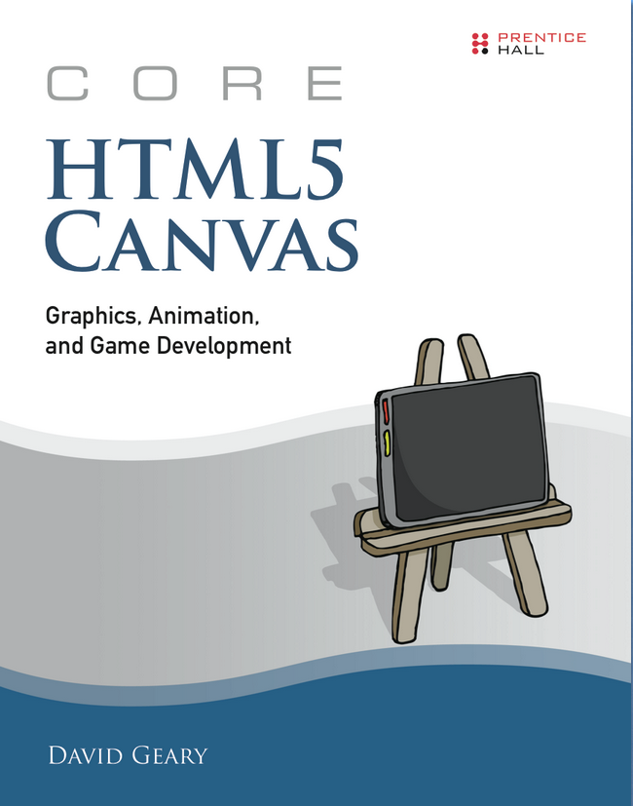
Further Reading
Core HTML5 Canvas
Free ebook!

Slide 22
Thank you

